Slide 1


HTML Fundamentals

Slide 2
Understanding HTML Fundamentals
THE BACKBONE OF WEB PAGES
HTML, or HyperText Markup Language, is the standard language for creating web pages. It defines the structure and content, acting as the skeleton of a website. Through HTML, developers can structure text, links, and images effectively.
HYPERTEXT MARKUP LANGUAGE (HTML)

Slide 3
Understanding Basic HTML Structure
HTML: ROOT ELEMENT
The html tag is the foundation of any web page, indicating to the browser that this is an HTML document.
HEAD: METADATA CONTAINER
The head tag contains important information about the web page, such as the title, character set, and links to stylesheets.
BODY: VISIBLE CONTENT
The body tag holds all the content that users see, including text, images, and other media displayed on the web page.

Slide 4
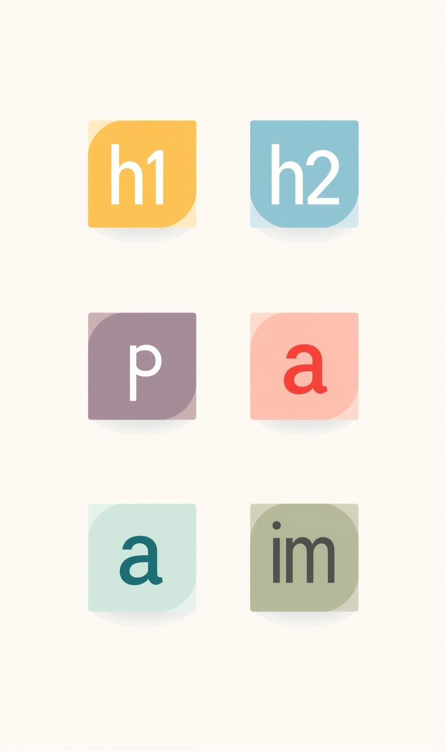
Fundamental HTML Tags for Web Content
ORGANIZING YOUR WEB PAGE
HTML provides essential tags to structure content effectively, helping with organization and readability. Key tags include headings, paragraphs, links, and images.
  Header Tag
  Paragraph Tag
  Button Tag
  Input Tag
  Ordered list Tag
  Unordered list Tag
  Dropdown list Tag
  Div Tag
  Script Tag

Slide 5
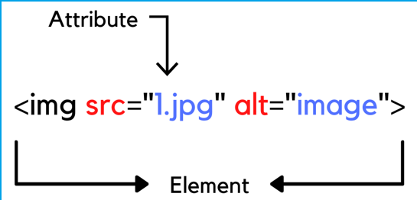
HTML Attributes
• Provide extra information
• Examples:
• href
• src
• alt
• id
• class

Slide 6
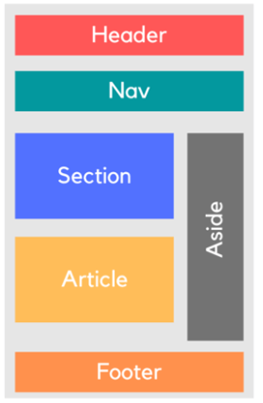
Semantic HTML
WHAT IS SEMANTIC HTML?
• MEANINGFUL HTML TAGS
• IMPROVES ACCESSIBILITY & SEO
Common Semantic Tags
• <header>
• <nav>
• <main>
• <section>
• <article>
• <footer>

Slide 7


Task: Create a single HTML page that represents a simple personal or business website using only HTML.
Your HTML page must include:
1️⃣ Basic HTML Structure
2️⃣ Semantic HTML Elements
Use at least 4 semantic elements
3️⃣ Content Elements
• At least 1 heading
• At least 2 paragraphs
• 1 image with alt attribute
• 1 link (<a>)
4️⃣ List
5️⃣ Form
Create a simple form that includes:
• Text input
• Email input
• Submit button
Deadline: Before next lecture

